Slide 1


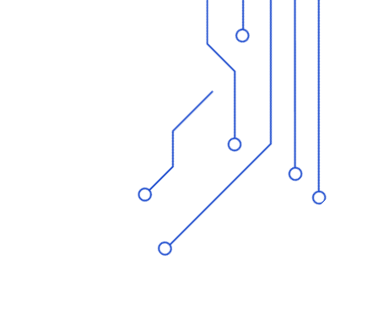



AI-POWERED BRAIN TUMOR CLASSIFIER
This presentation outlines the development and functionality of an AI-powered clinical assistant that seamlessly integrates brain MRI tumor classification with PDF-based clinical report Q&A, leveraging deep learning for medical image analysis and natural language processing for document understanding.
ANN KASZYNSKA

Slide 2









PROJECT OVERVIEW
AI-Powered Clinical Assistant
INTEGRATION OF AI AND IMAGING
MRI BRAIN TUMOR DIAGNOSTICS
Combines computer vision with generative AI for enhanced diagnostics.
Assists clinicians in identifying brain tumors from MRI images effectively.
INTERACTIVE CLINICAL Q&A
TECHNOLOGY STACK UTILIZATION
Answers clinical queries based on associated reports for clinicians.
Utilizes Streamlit, PyTorch, and Google's Gemini API for robust functionality.

Slide 3
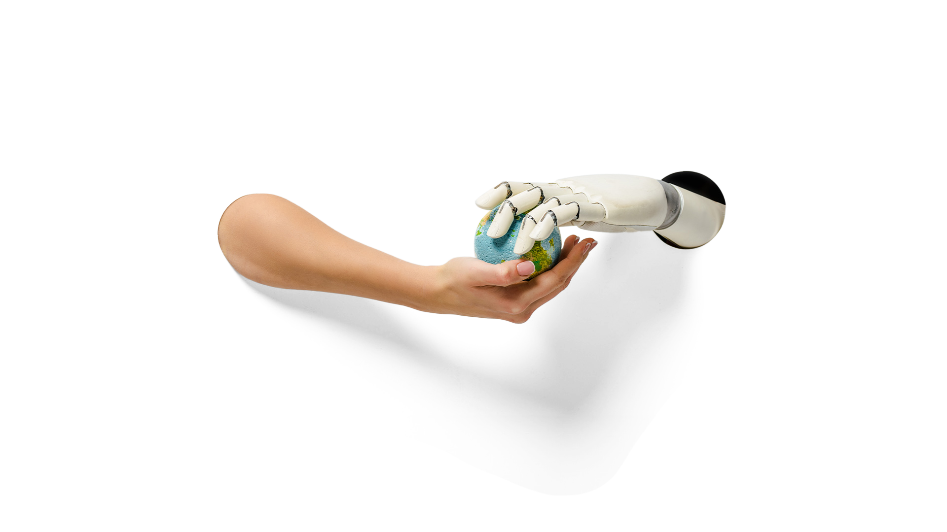






SYSTEM ARCHITECTURE OVERVIEW
Integrating AI for Brain Tumor Classification
MRI IMAGE CLASSIFICATION
PDF TEXT EXTRACTION
GENERATIVE AI Q&A
WEB INTERFACE WITH STREAMLIT
Utilizes a Vision Transformer (ViT) for accurate analysis of MRI images to assist in diagnosis.
Extracts relevant text from clinical reports, enhancing context understanding for users.
Employs Generative AI for interactive clinical question and answer functionalities to support healthcare professionals.
Features a user-friendly web interface built on Streamlit to facilitate easy access to AI tools.

Slide 4
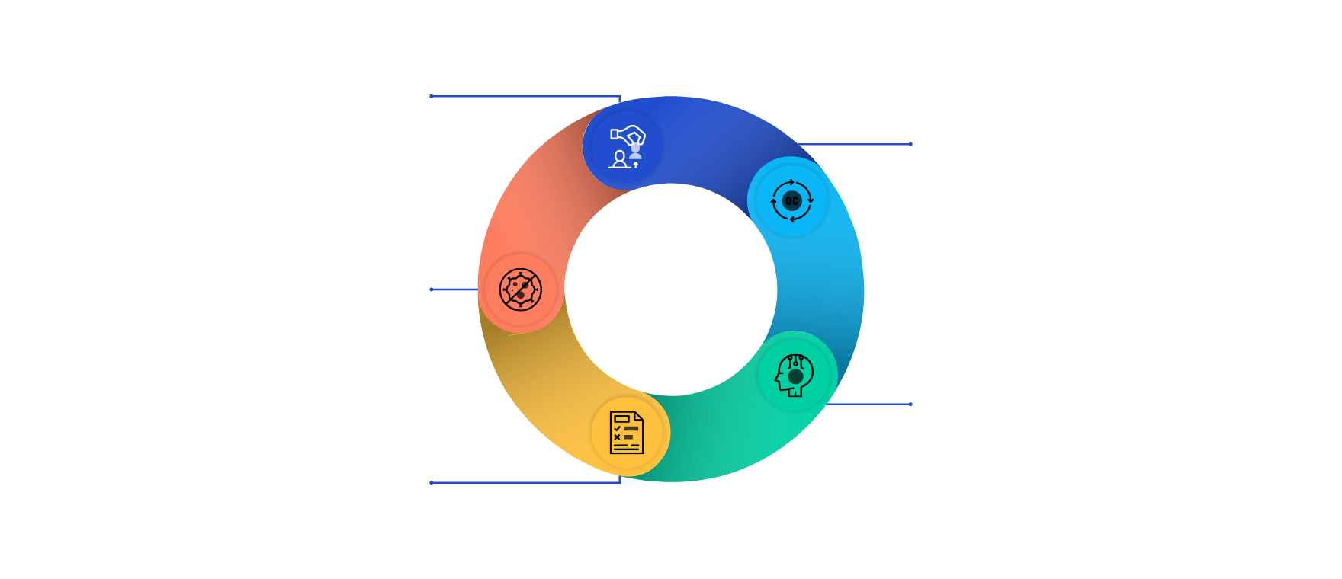
MRI IMAGE CLASSIFICATION USING VISION TRANSFORMER
Fine-tuned ViT model classifies MRI scans into tumor categories
PRE-TRAINED VISION TRANSFORMER MODEL
The base model is a ViT pre-trained on ImageNet1K dataset for robust feature extraction.
FINE-TUNING FOR TUMOR CLASSIFICATION
Model adapted to classify MRI images into four categories: glioma, meningioma, pituitary tumor, or no tumor.
TUMOR CLASSES DEFINED
Four tumor categories used: glioma_tumor, meningioma_tumor, no_tumor, and pituitary_tumor.
OUTPUT LAYER CUSTOMIZED
The classification head replaced with a linear layer mapping to four tumor classes.
MODEL EVALUATION MODE ENABLED
Model set to evaluation mode to ensure consistent inference behavior during classification.

Slide 5






IMAGE PREPROCESSING
Preparing MRI Images for Inference
CONVERTS IMAGE TO GRAYSCALE
RESIZING TO STANDARD DIMENSIONS
EXPANDING DIMENSIONS
NORMALIZATION
CONVERSION TO TENSOR
Initial step converts the uploaded image to grayscale to reduce dimensionality.
Dimensions are expanded to create compatibility with model input requirements.
Pixel values are normalized to a range of 0 to 1, facilitating better model performance.
Finally, the image is transformed into a tensor suitable for the model inference.
The image is resized to 128x128 pixels, ensuring uniformity across inputs.

Slide 6

MODEL INFERENCE AND TUMOR PREDICTION
Understanding the process of passing image tensors through AI model to classify brain tumors with confidence scoring
01
INPUT IMAGE TENSOR PROCESSING
The pre-processed image tensor is fed into the AI model for tumor classification inference.
02
MODEL OUTPUT AND PROBABILITY SCORES
Model generates raw output logits which are converted into probability scores via softmax function.
03
PREDICTION WITH HIGHEST CONFIDENCE
The index of highest probability determines tumor class prediction along with confidence percentage.
04
CLASSIFICATION FUNCTION LOGIC
The classify function applies no-gradient mode, computes softmax, finds max index, and returns class and confidence.

Slide 7




01
PURPOSE OF EXTRACTION
Extract text from uploaded clinical PDFs to provide context for clinical questions and answers.
02
EXTRACTION METHOD
Uses Python code leveraging fitz (PyMuPDF) to read and parse each page's text from PDF streams.
PDF CLINICAL REPORT EXTRACTION
Extracting text from clinical PDF files to enable context-aware Q&A
03
04
ERROR HANDLING
Captures exceptions during extraction and returns an error message for debugging or user feedback.
INTEGRATION BENEFIT
Provides extracted text as context input to clinical AI models, enabling more accurate and relevant answers.

Slide 8







PROMPT ENGINEERING FOR CLINICAL AI Q&A
INTEGRATES MRI PREDICTIONS AND CONFIDENCE
Combining MRI predictions, context, and user questions to optimize AI responses
The prompt includes MRI prediction results with confidence scores to guide AI interpretation.
INCORPORATES PATIENT REPORT CONTEXT
Relevant excerpts from clinical reports are added to enrich the AI's understanding of the case.
INCLUDES USER QUESTIONS EXPLICITLY
User queries are directly embedded in the prompt to tailor AI responses precisely to the inquiry.
STRUCTURED PROMPT FOR GENERATIVE AI
The final prompt is a formatted string combining all elements for effective AI clinical assistance.

Slide 9
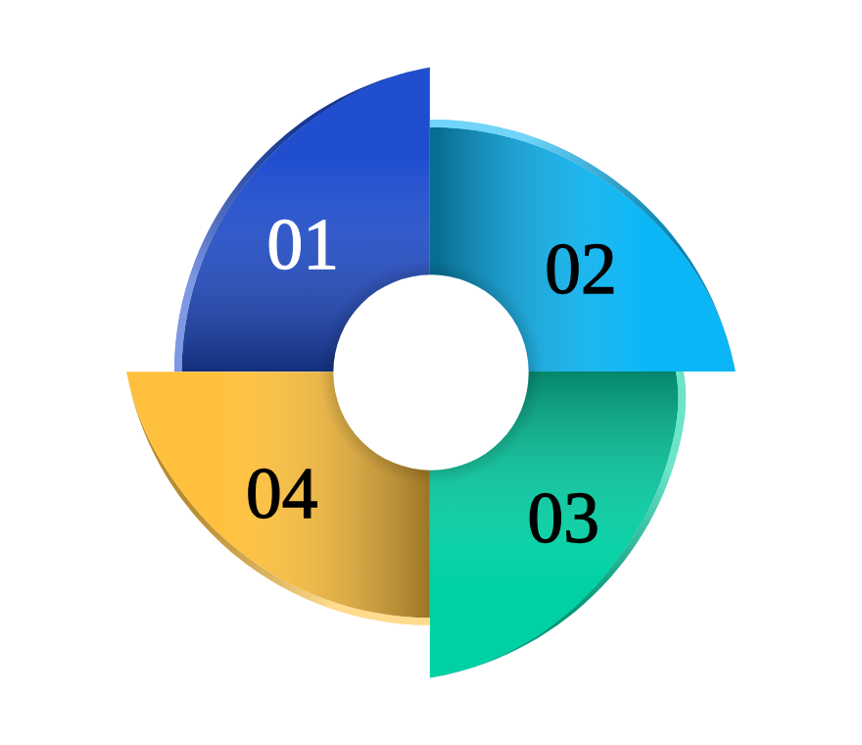
GENERATIVE AI Q&A INTEGRATION
Leveraging Google Gemini for Context-Aware Clinical Answers
GOOGLE GEMINI POWERS ANSWER GENERATION
Utilizes Gemini model 1.5 Flash to generate relevant and accurate answers to clinical queries.
INPUTS: MRI PREDICTIONS AND REPORTS
Combines MRI brain tumor classification outputs with clinical report context for comprehensive Q&A.
CONTEXT-AWARE CLINICAL ASSISTANT
System enables clinicians to query brain tumor info intelligently with integrated imaging and report data.
AI FUNCTION PROCESSES IMAGE AND PROMPT
Code snippet defines ask_gemini that generates answers using both visual and text inputs.

Slide 10


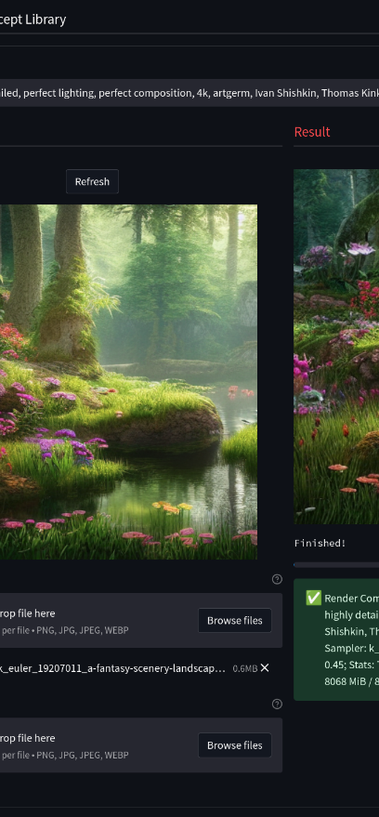



STREAMLIT USER INTERFACE
Interactive Tool for Brain Tumor Classification
WEB INTERFACE FOR UPLOADS
A user-friendly web interface that allows users to upload images and PDFs easily.
REAL-TIME PREDICTIONS
Displays predictions instantly after users upload files, enhancing user experience.
INTERACTIVE Q&A PANEL
Users can engage with an interactive Q&A panel for additional support and clarification.

Slide 11

EXPLORE FUTURE OPPORTUNITIES IN AI INTEGRATION
This project showcases an end-to-end AI assistant that integrates vision models, NLP, and generative AI for clinical decision-making, highlighting the transformative potential of AI in healthcare. Future enhancements may include support for multiple users, refined retrieval strategies, and seamless integration with hospital information systems.

